Slide 1
Capstone Project - The Battle of Neighborhoods (Week 2)

Slide 2
1.Introduction
This project aims to select the safest borough in London based on the total crimes, explore the neighborhoods of that borough to find the 10 most common venues in each neighborhood and finally cluster the neighborhoods using k-mean clustering.
We will focus on the safest borough and explore its neighborhoods and the 10 most common venues in each neighborhood so that the best neighborhood suited to an individual's needs can be selected.

Slide 3
2. Data Acquisition
Data Acquisition-Data acquired for this project is a combination of data from three sources:
The first data source of this project uses a London Crime Data that shows a crime per borough in London.
The second source of data scraped from Wikipedia page that contain list of London Boroughs.
The third source is the list of neighborhood in Royal Boroughs of Kingston upon Thames as found on Wikipedia page

Slide 4
3.Data Cleaning
Data Cleaning- These process is different for each of the three source.
The total number of crimes commited in each of the borough during the last year. The most common venues in each of the neighborhood in the safest borough selected.
Scraping additional information of the different Boroughs in London from a Wikipedia page. More information regarding the boroughs of London is scraped using the Beautifulsoup library.
Creating a new dataset of the Neighborhoods of the safest borough in London and generating their co-ordinates.: Co-ordinate of neighborhood will be obtained using Google Maps API geocoding.

Slide 5
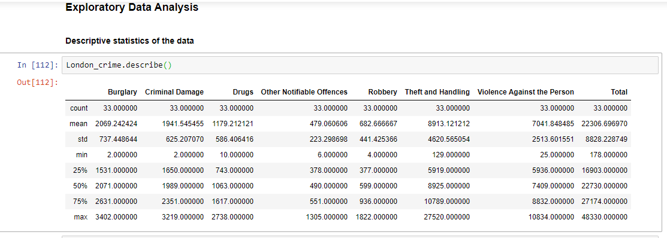
4.Methodology
Exploratory Data Analysis:
Visualize the crime rates in the London boroughs to identify the safest borough and extract the neighborhoods in that borough to find the 10 most common venues in each neighborhood.

Slide 6
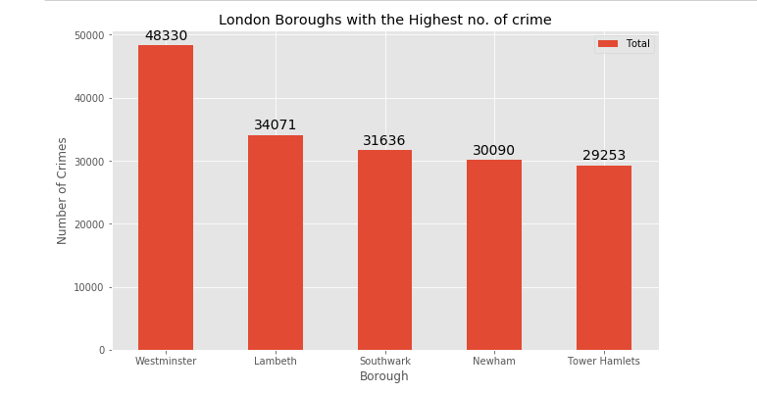
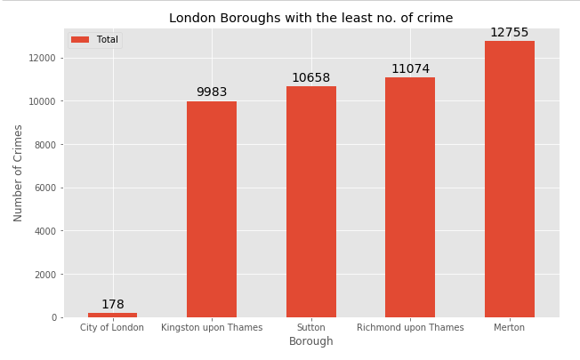
The borough City of London has the lowest no. of crimes recorded for the year 2016, Looking into the details of the borough:

Slide 7
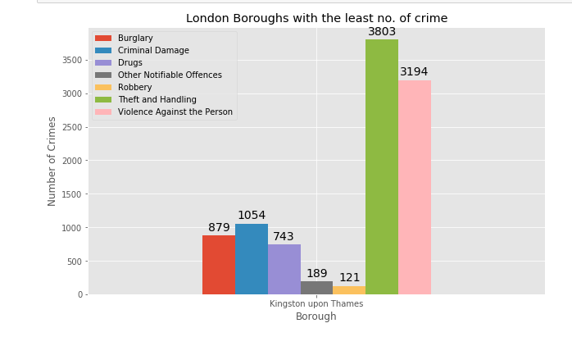
We can conclude that Kingston upon Thames is the safest borough when compared to the other boroughs in London.

Slide 8
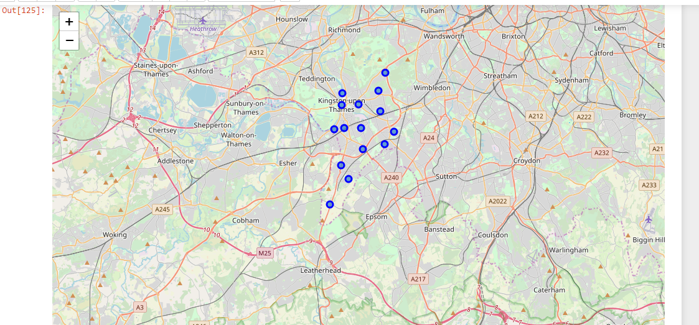
Neighbors in Kingston upon Thames
There are 15 Neighborhoods in Royal borough of Kingston upon Thames, they are visualize on map using Folium on python.

Slide 9
Modelling
To help people find similar neighborhoods in the safest borough we will be clustering similar neighborhoods using K - means clustering which is a form of unsupervised machine learning algorithm that clusters data based on predefined cluster size.
We will use a cluster size of 5 for this project that will cluster the 15 neighborhoods into 5 clusters.
The reason to conduct a K- means clustering is to cluster neighborhoods with similar venues together so that people can shortlist the area of their interests based on the venues/amenities around each neighborhood.

Slide 10
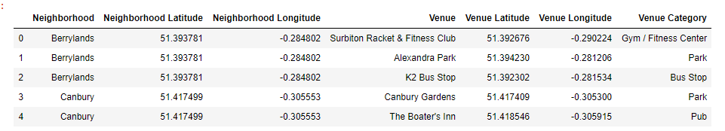
Using the final data set containing the neighborhood in kingston upon the themes along with the latitude and longitude, we can find all venues within 500 m radius of each neighborhood by connecting it to the foursquare API.
Using One Hot Encoder Grouping rows by neighborhood and by taking the mean of the frequency of occurrence of each category, Finally the 10 common venues are calculated for the neighborhoods.

Slide 11
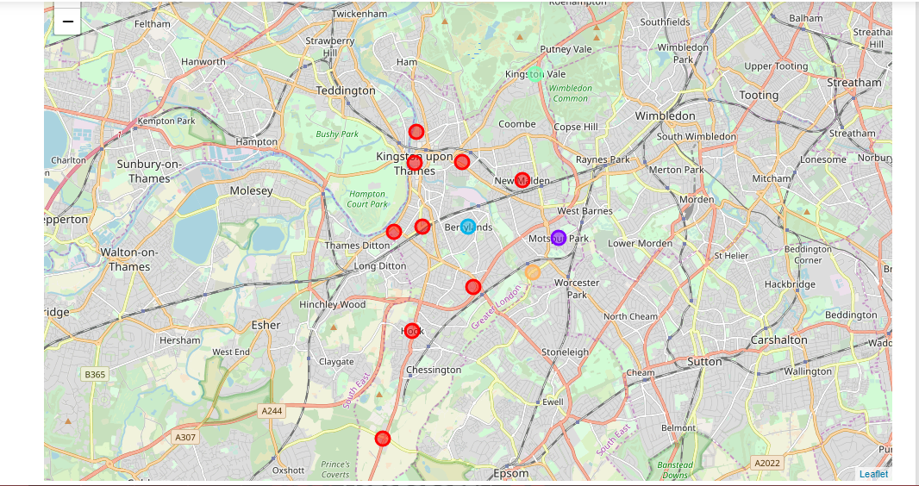
Results
Each cluster is color coded for the ease of presentation, we can see that majority of the neighborhood falls in the red cluster which is the first cluster. Three neighborhoods have their own cluster (Blue, Purple and Yellow), these are clusters two three and five. The green cluster consists of two neighborhoods which is the 4th cluster.

Slide 12
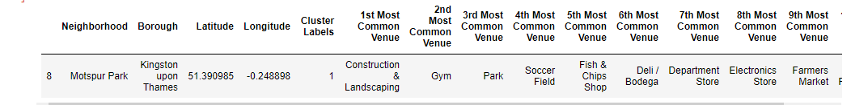
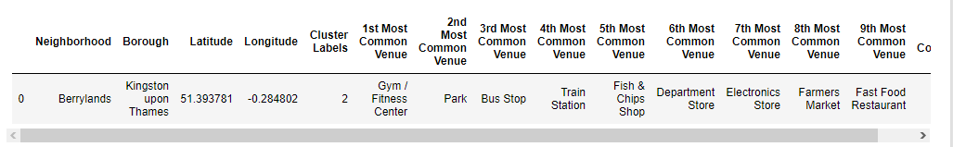
Examine the second cluster
In second cluster, these neighborhoods have common venues such as Construction & Landscaping, Parks, Gym/Fitness centers, Bus Stops, Restaurants, Electronics Stores and Soccer fields .
Examine the third cluster
In third cluster, these neighborhoods have common venues such as Parks, Gym/Fitness centers, Bus Stops, Restaurants,Departmental strors, Electronics Stores and train station etc

Slide 13
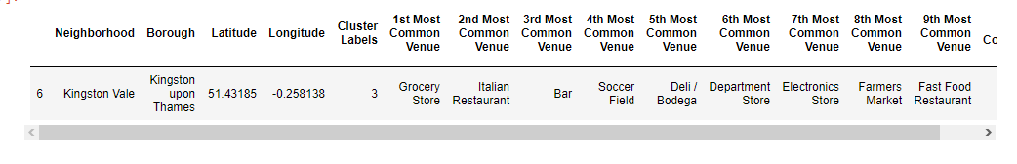
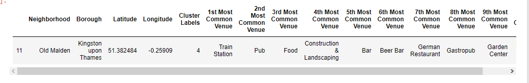
Examine the forth cluster
The forth cluster has one neighborhood which consists of Venues such as Grocery shops, Bars, Restaurants, Furniture shops, and Department stores.
Examine the fifth cluster
The Fifth cluster has one neighborhood which consists of Venues such as Train stations, Restaurants, and Furniture shops.

Slide 14
Discussion
The aim of this project is to help people who want to relocate to the safest borough in London, expats can chose the neighborhoods to which they want to relocate based on the most common venues in it.
For example if a person is looking for a neighborhood with good connectivity and public transportation we can see that Clusters 3 and 4 have Train stations and Bus stops as the most common venues.
If a person is looking for a neighborhood with stores and restaurants in a close proximity then the neighborhoods in the first cluster is suitable.
For a family I feel that the neighborhoods in Cluster 4 are more suitable dues to the common venues in that cluster, these neighborhoods have common venues such as Parks, Gym/Fitness centers, Bus Stops, Restaurants, Electronics Stores and Soccer fields which is ideal for a family.

Slide 15
Conclusion
This project helps a person get a better understanding of the neighborhoods with respect to the most common venues in that neighborhood.
It is always helpful to make use of technology to stay one step ahead i.e. finding out more about places before moving into a neighborhood.
We have just taken safety as a primary concern to shortlist the borough of London. The future of this project includes taking other factors such as cost of living in the areas into consideration to shortlist the borough based on safety and a predefined budget

